Slide 1

COLOR SELECTION AND EDITING FOR PALETTE-BASED PHOTO RECOLORING
IMAGE PROCESSING LAB
MINI PROJECT
GROUP 7
ARNAB BISWAS (21EC65R01)
MOHIT GUPTA (21EC65R17)

Slide 2
AIM
To perform reflectance color transfer of an image
For Lighting the Palette
To overcome the problems in the Chang’s paper

Slide 3
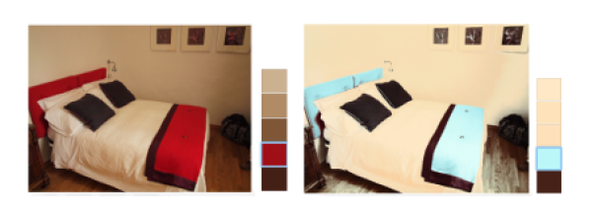
Problem in Chang’s Paper
Change the Luminance of the given image

Slide 4
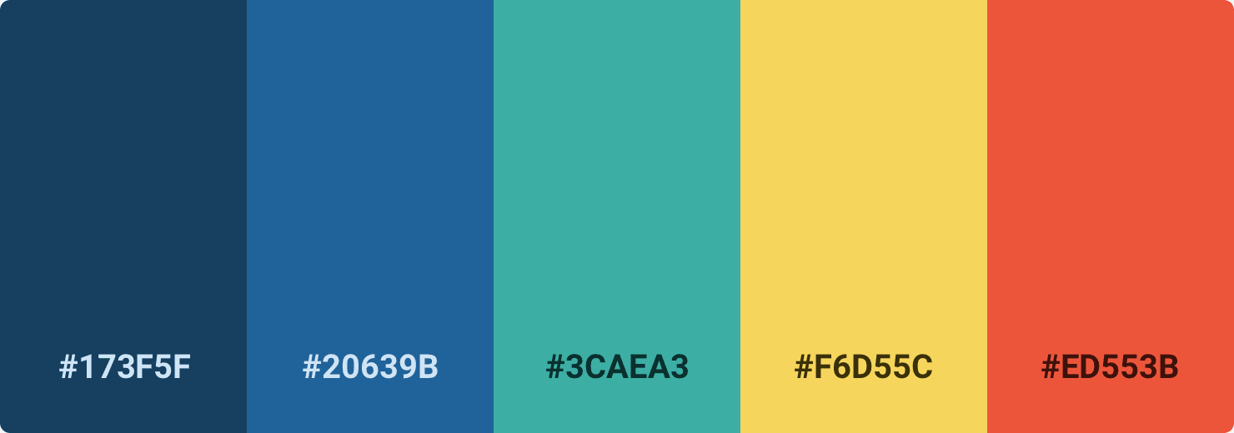
COLOR PALETTE
The word 'colour palette,' sometimes known as 'palette,' refers to the whole range of colours that a digital device

Slide 5
STEPS INVOLVED
INTRINSIC DECOMPOSITION
PALETTE EXTRACTION
COLOR TRANSFER
LIGHTING PALETTE

Slide 6
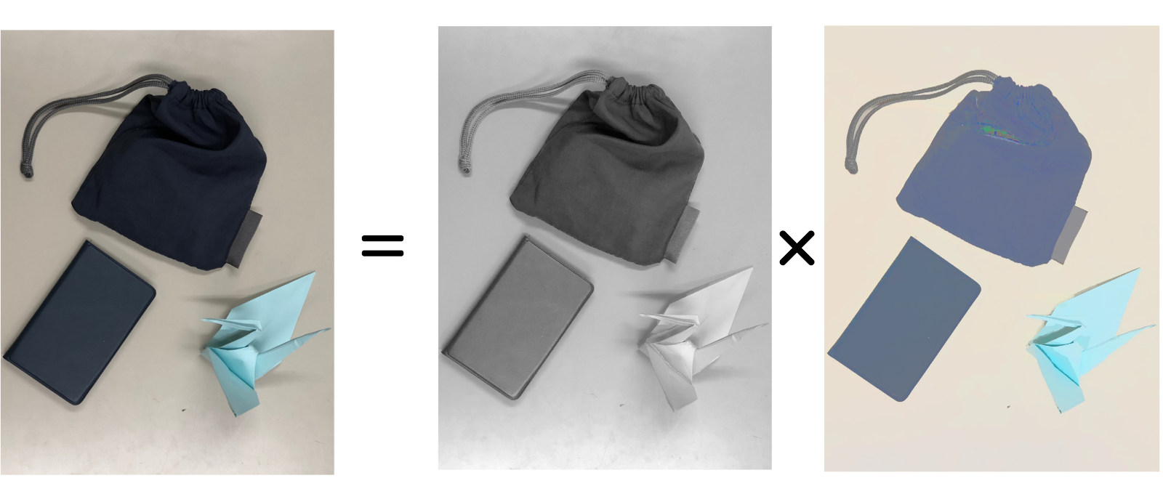
STEP 1:
INTRINSIC IMAGE DECOMPOSITION
Intrinsic decomposition gives output as two images Reflectance (R) and Shading (S)

Slide 7
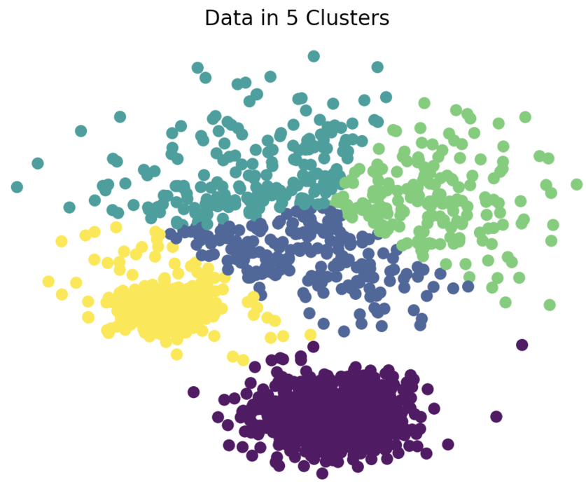
STEP 2: PALETTE EXTRACTION
K- means Algorithm

Slide 8
VALUE OF K
If k is so small, then some colors to be changed might not be well-represented
If k is so large, then the user may have to change a large subset to get a desired change
Typically k value should be between 3 to 7.

Slide 9
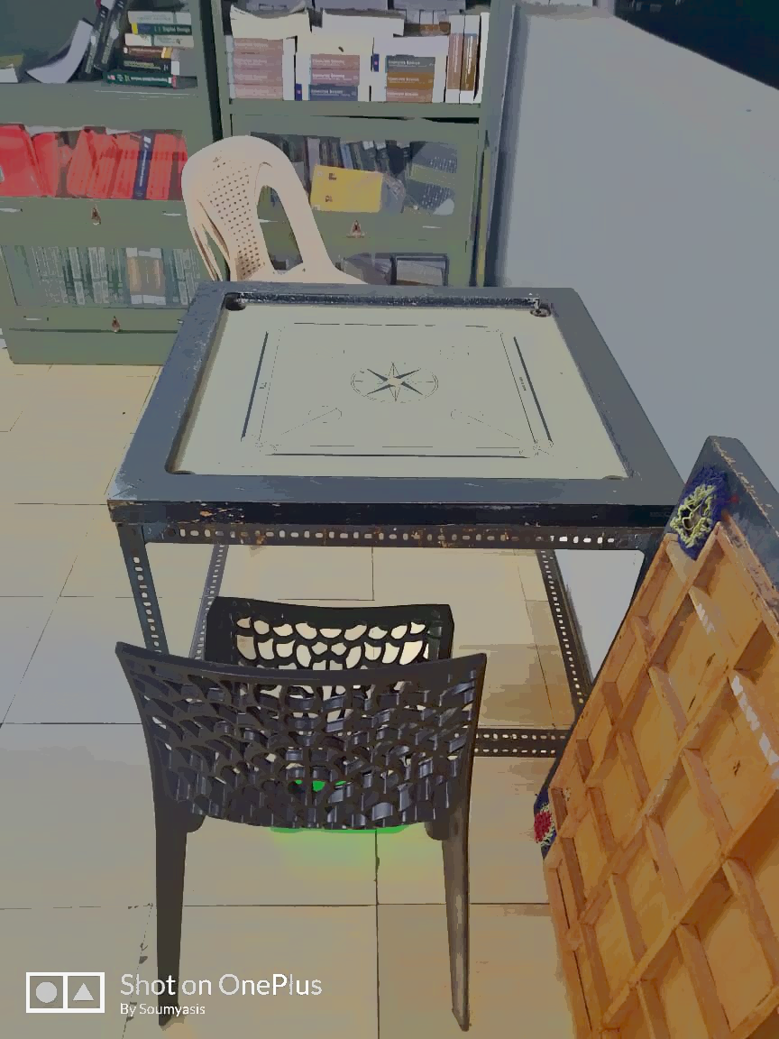

Extracted Palette

Slide 10
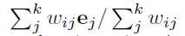
STEP 3: REFLECTANCE COLOR TRANSFER
The editing result y of the i-th pixel is given by:
The expression of E_{i} is given by :
The value of e_{j} is:

Slide 11
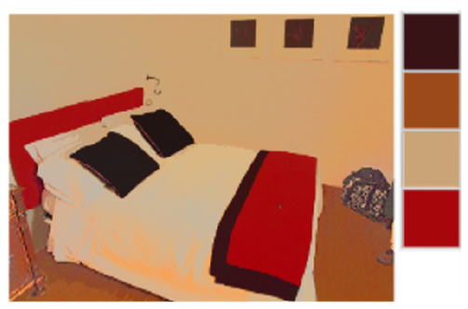
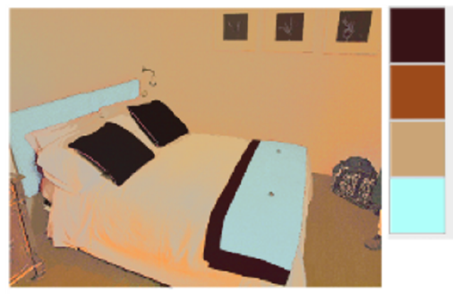
Example of Reflectance Color Transfer
R
R’

Slide 12
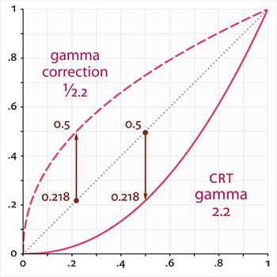
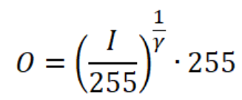
STEP 4: LIGHTING PALETTE
Gamma correction:

Slide 13
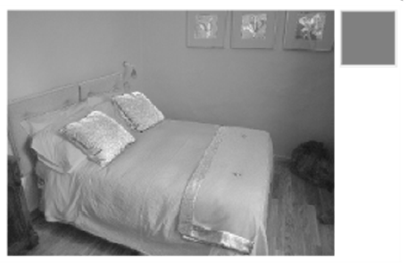
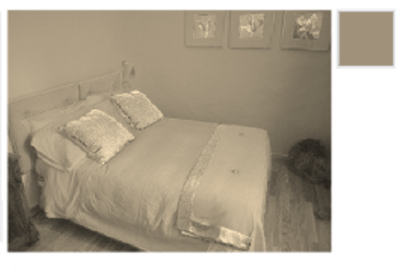
Image after Gamma Correction
S
S’

Slide 14
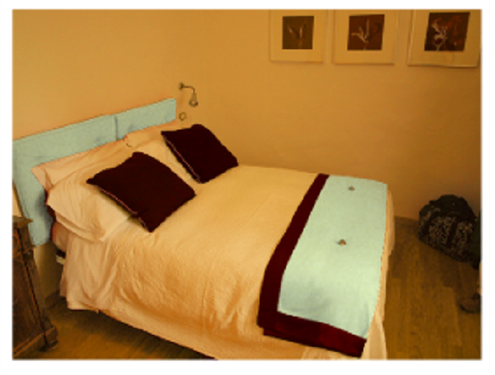
Finally modified image:
I = R’ * S’

Slide 15
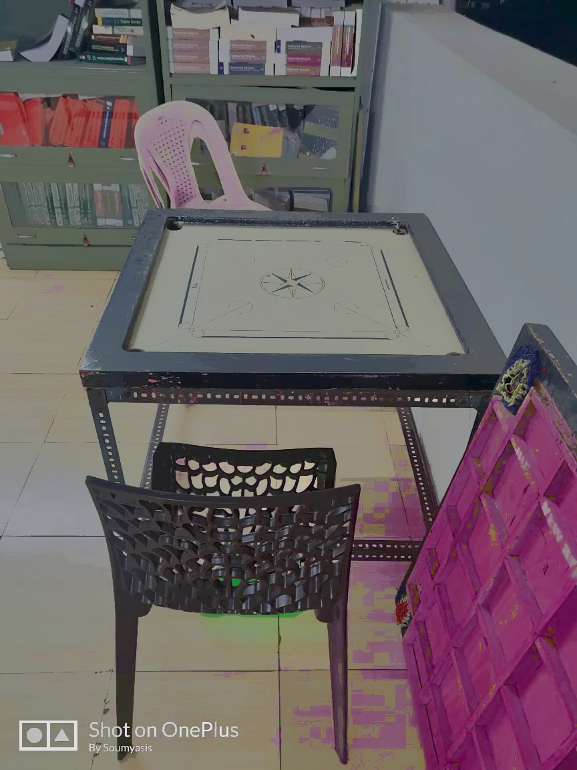
Our Results:
Input image
Output image

Slide 16
SUMMARY:
Color palette of the image can be modified.
This method allows both object and lighting color editing while preserving the natural luminance order by separately dealing with the reflectance and shading.
Problem of luminance is solved.

Slide 17
THANK YOU

